Slide 1
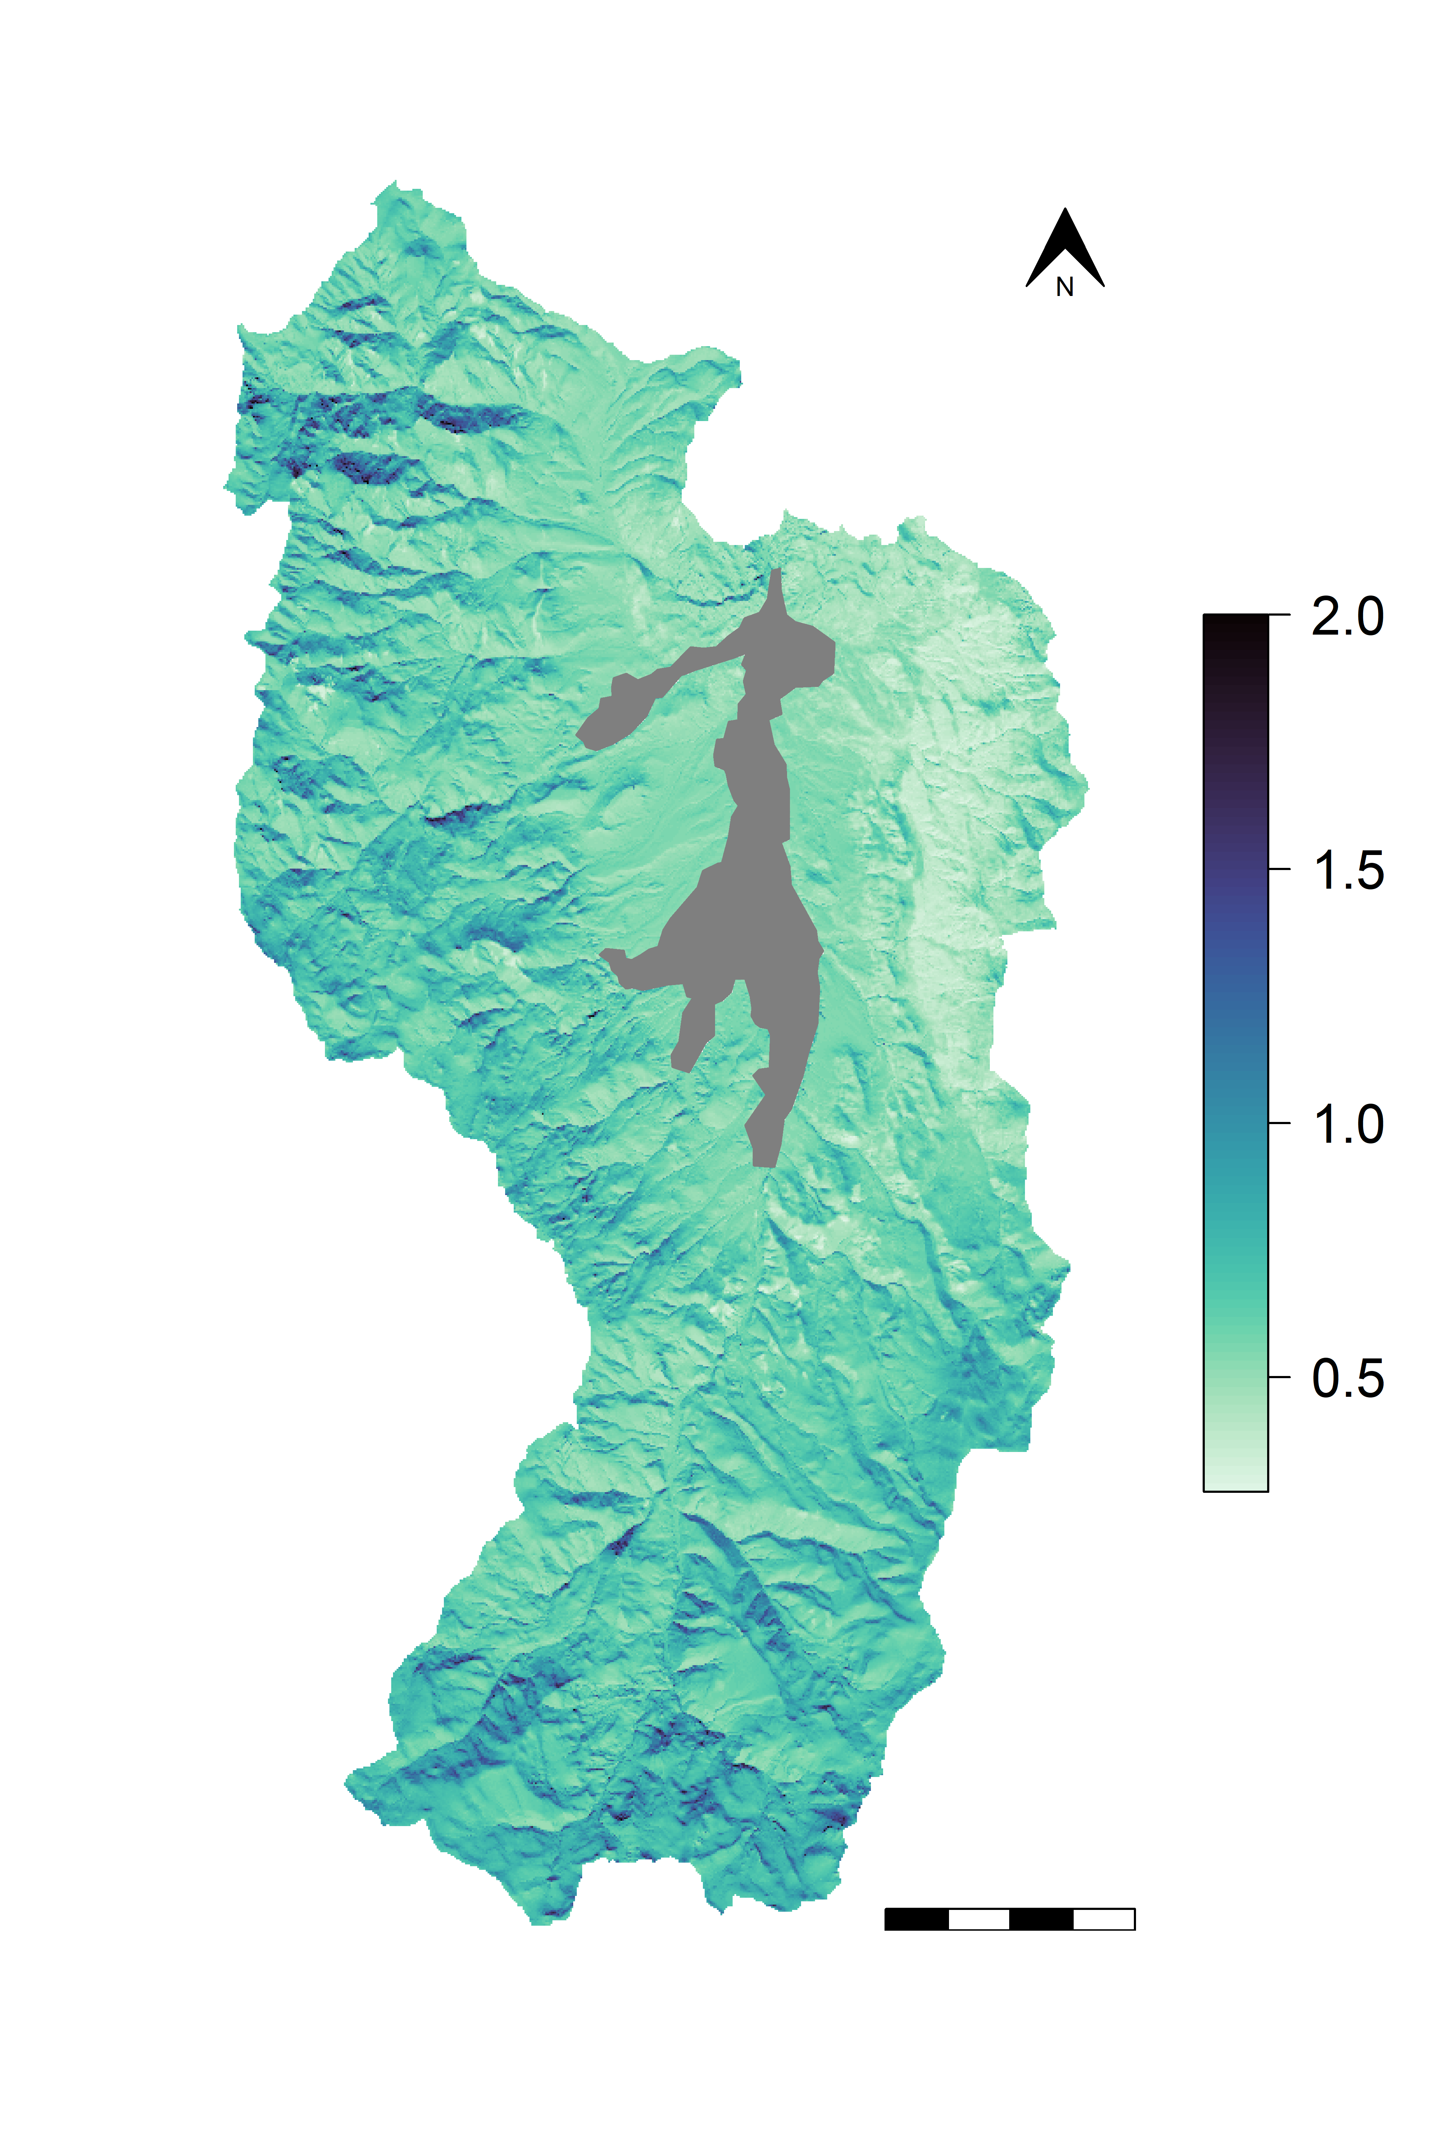
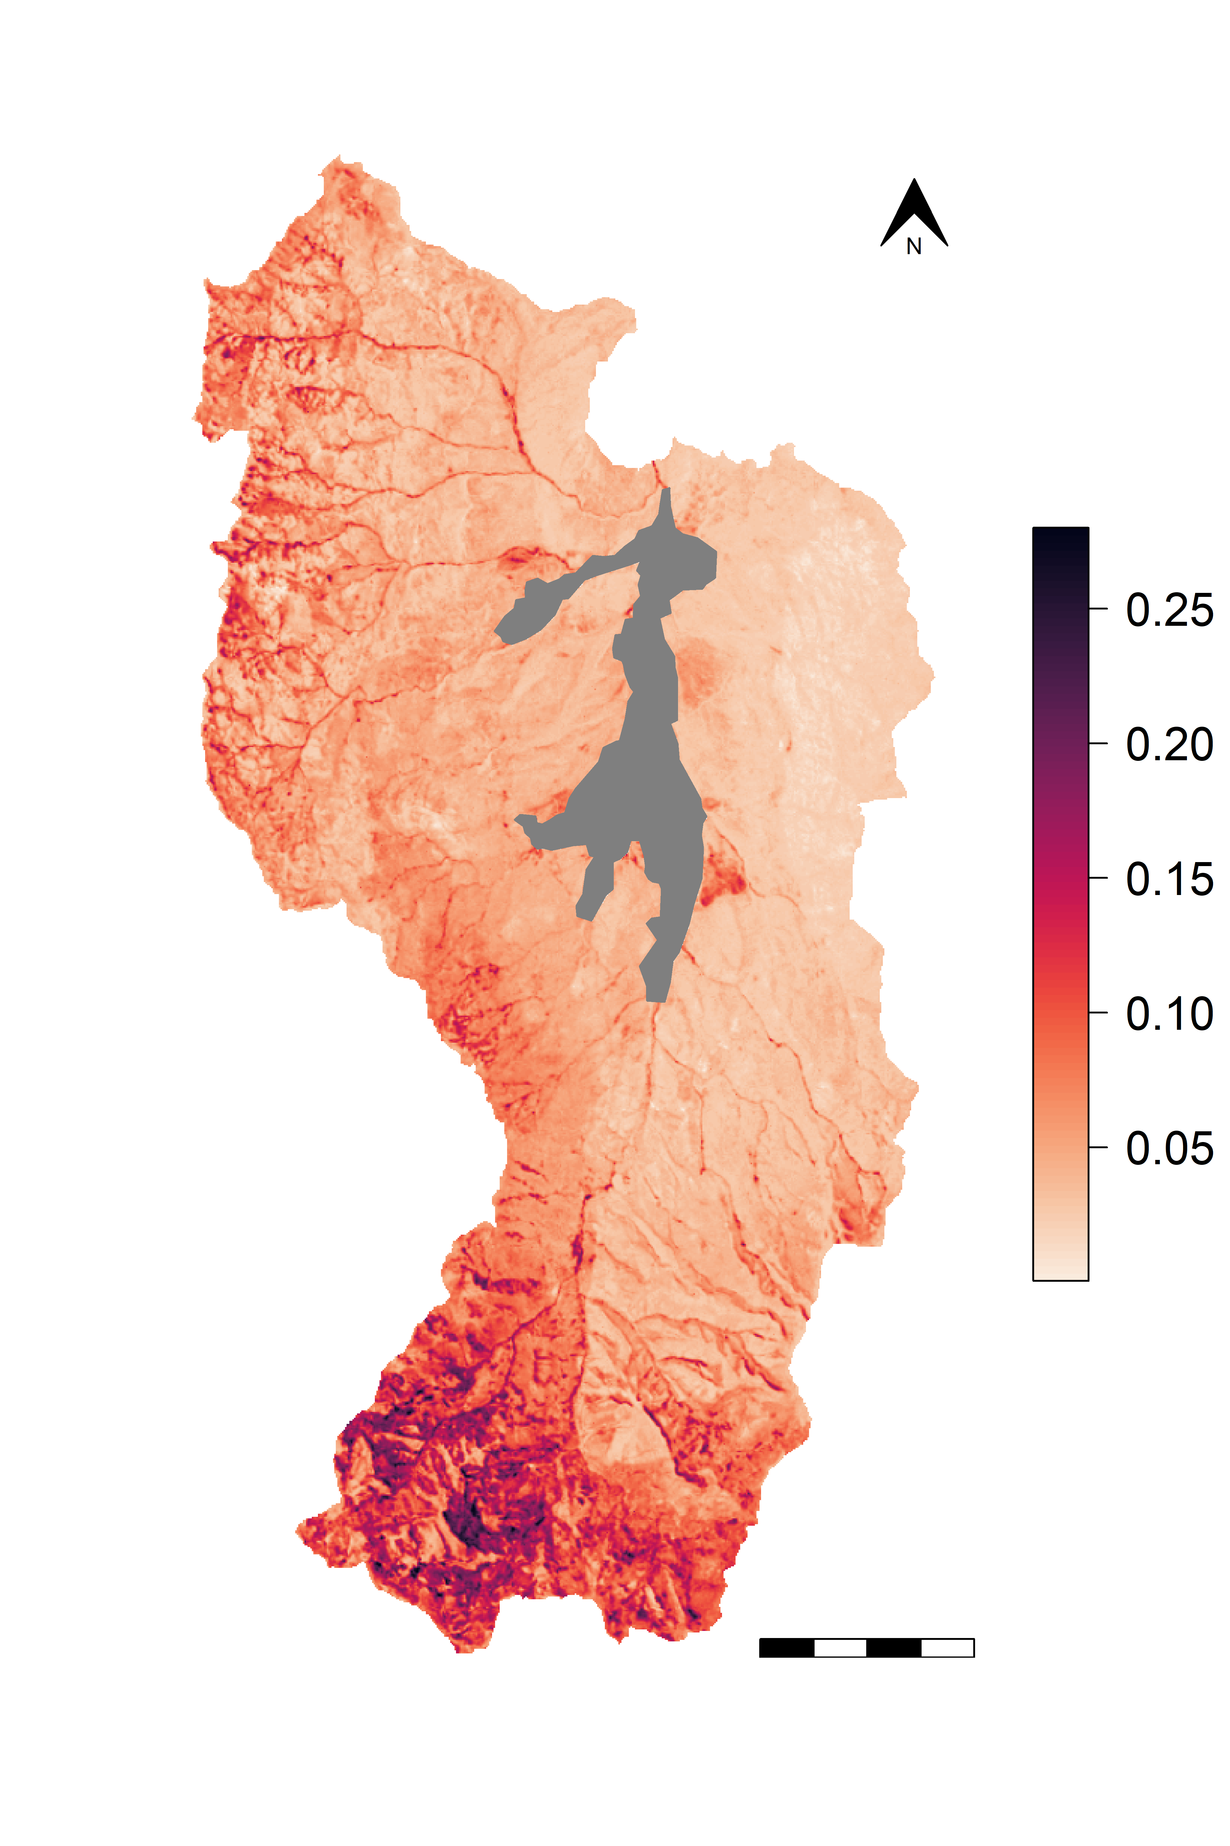
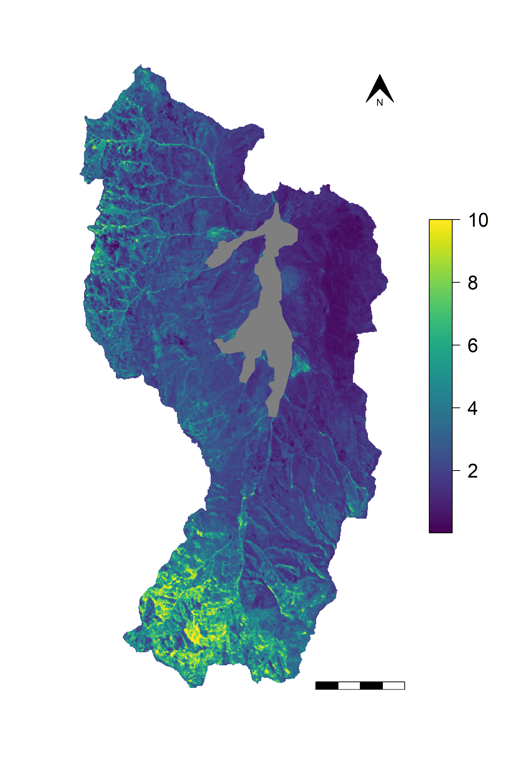

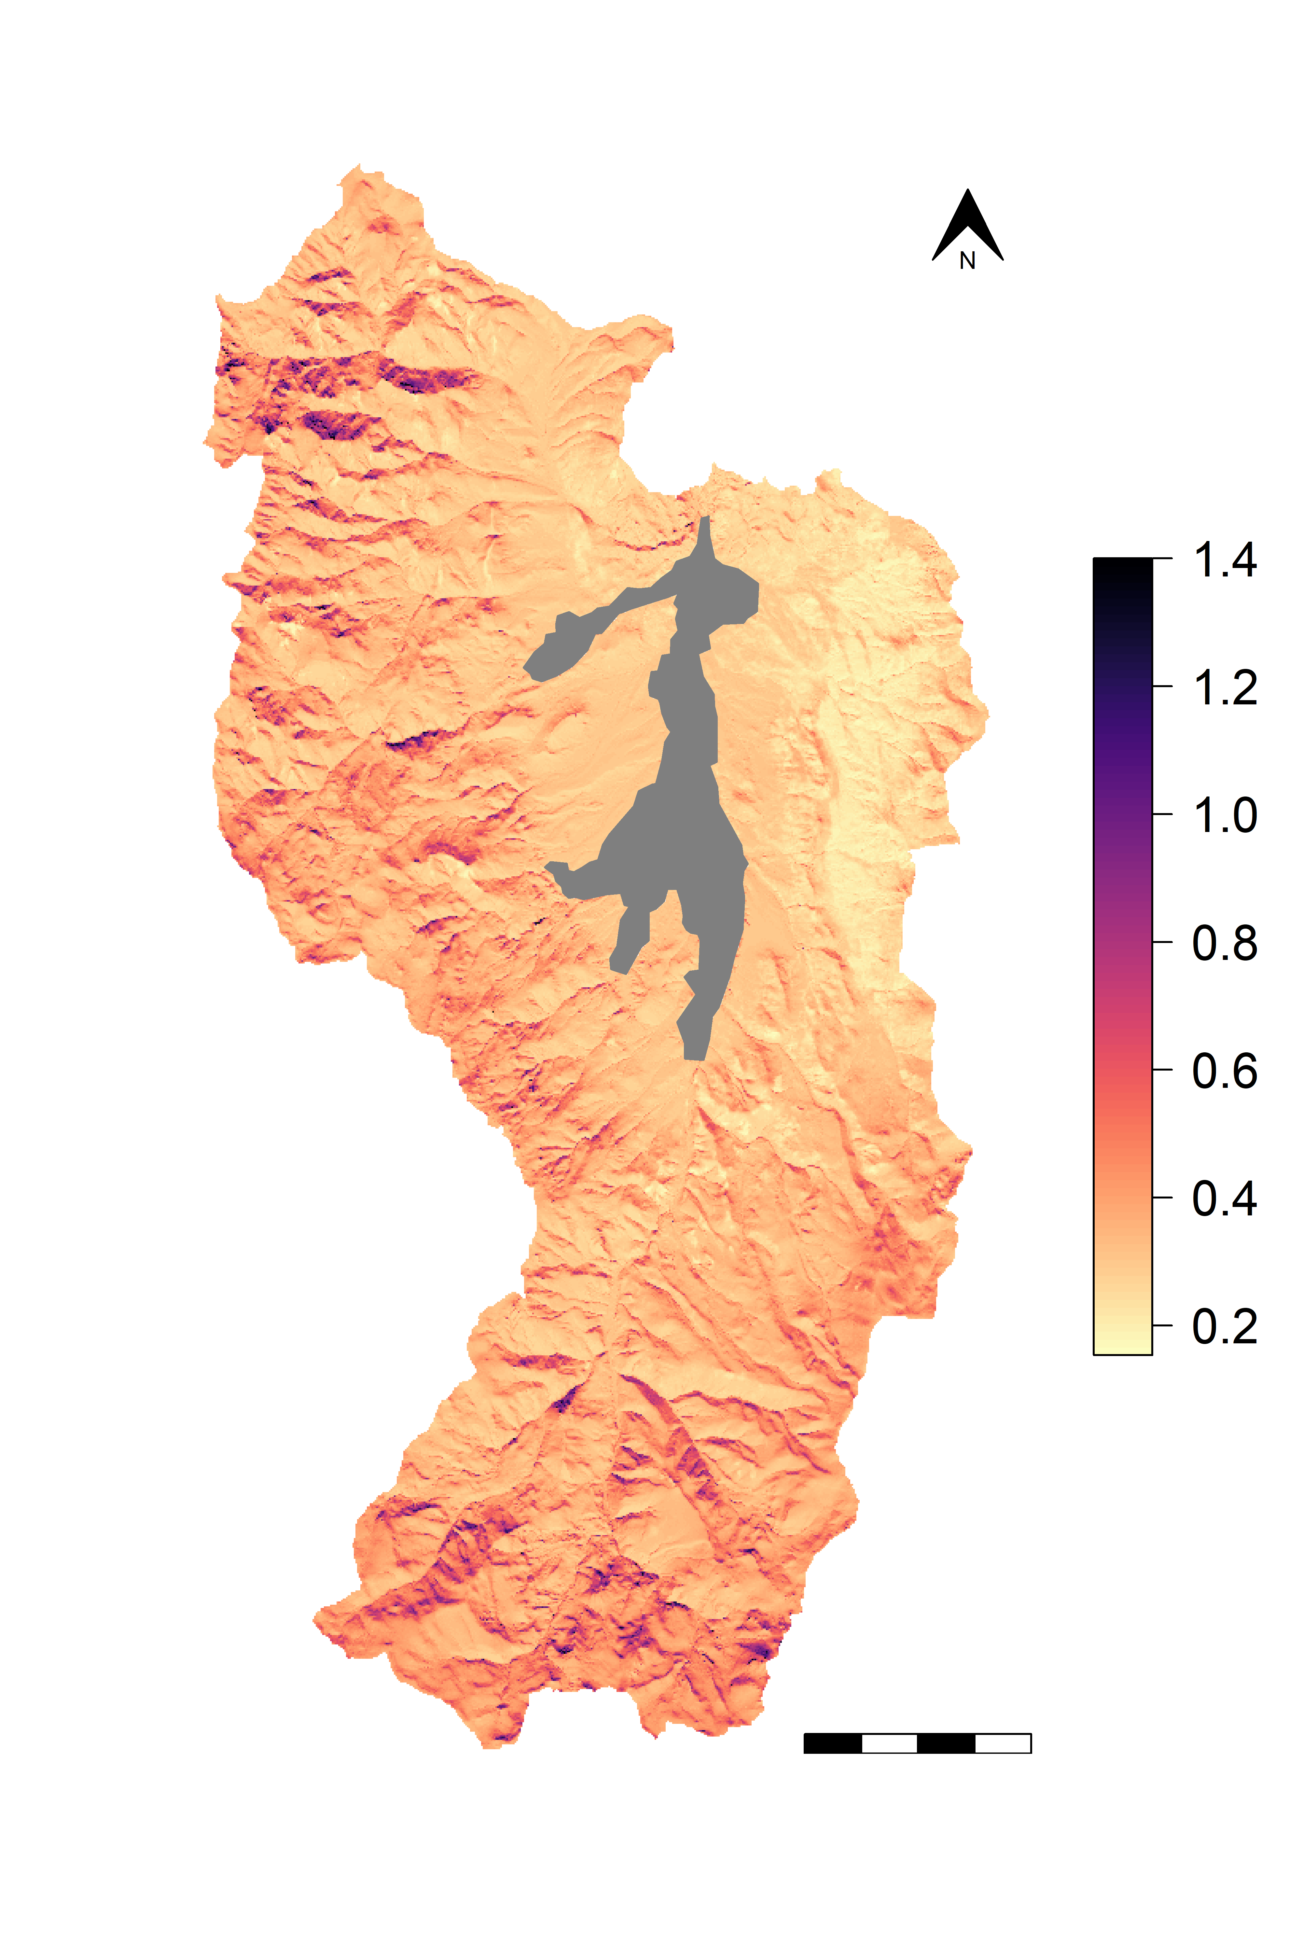
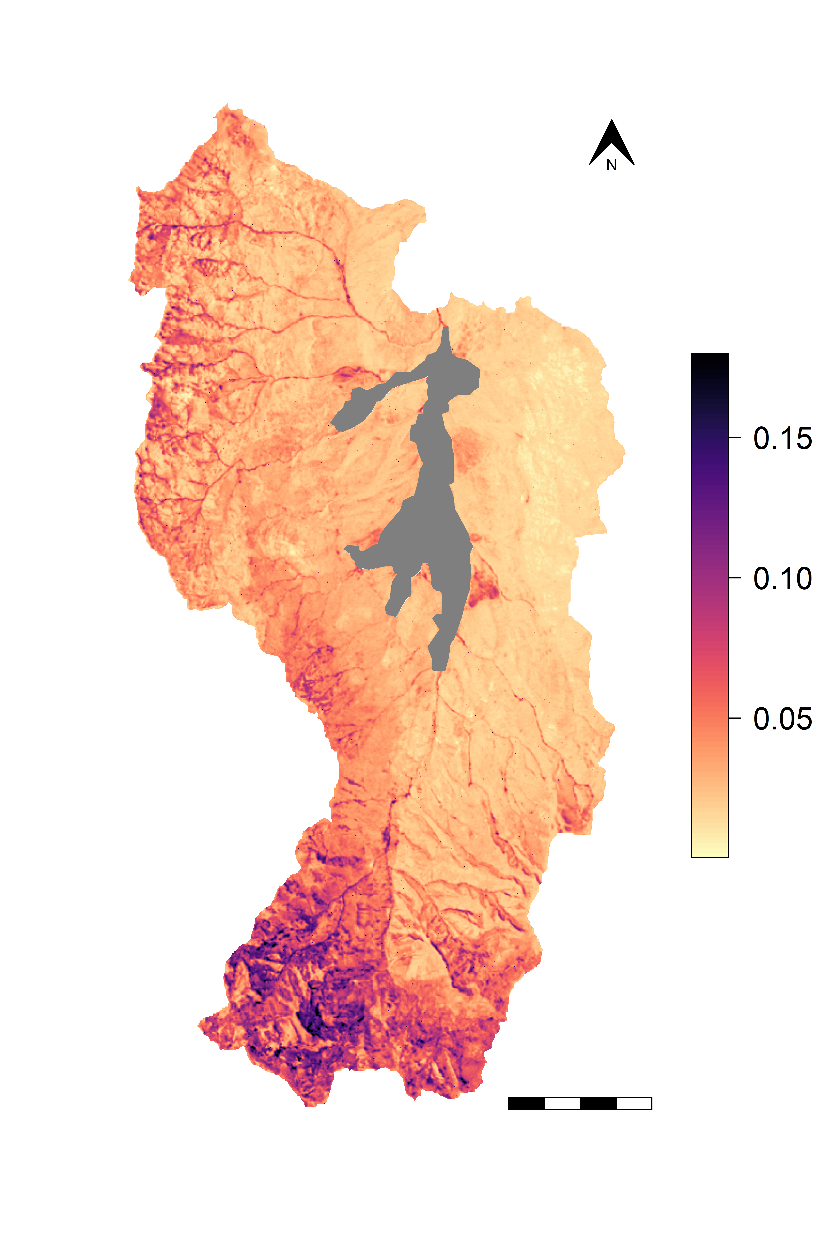
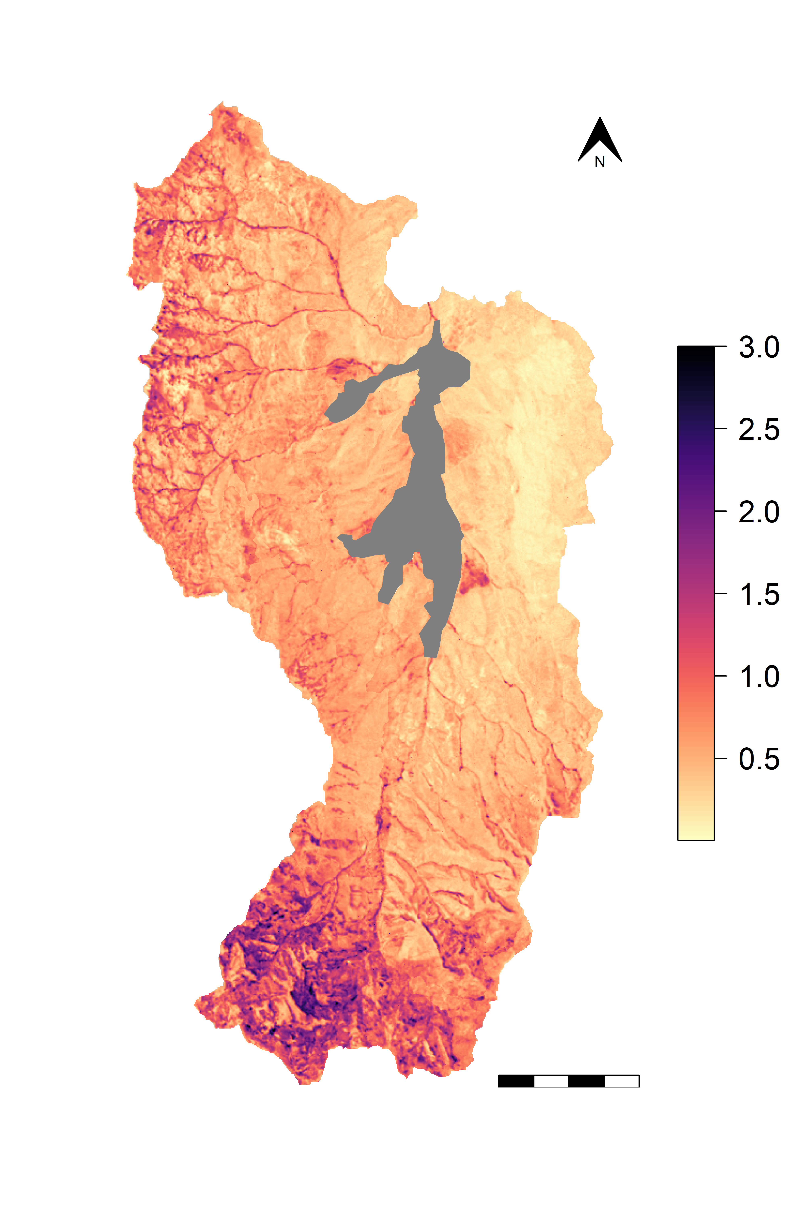
A
Litter C
Microbial C
Protected SOC
Estimate (kgC m⁻²)
Estimate (kgC m⁻²)
Estimate (kgC m⁻²)
4 km
B
Standard Deviation (kgC m⁻²)
Standard Deviation (kgC m⁻²)
Standard Deviation (kgC m⁻²)

Slide 2
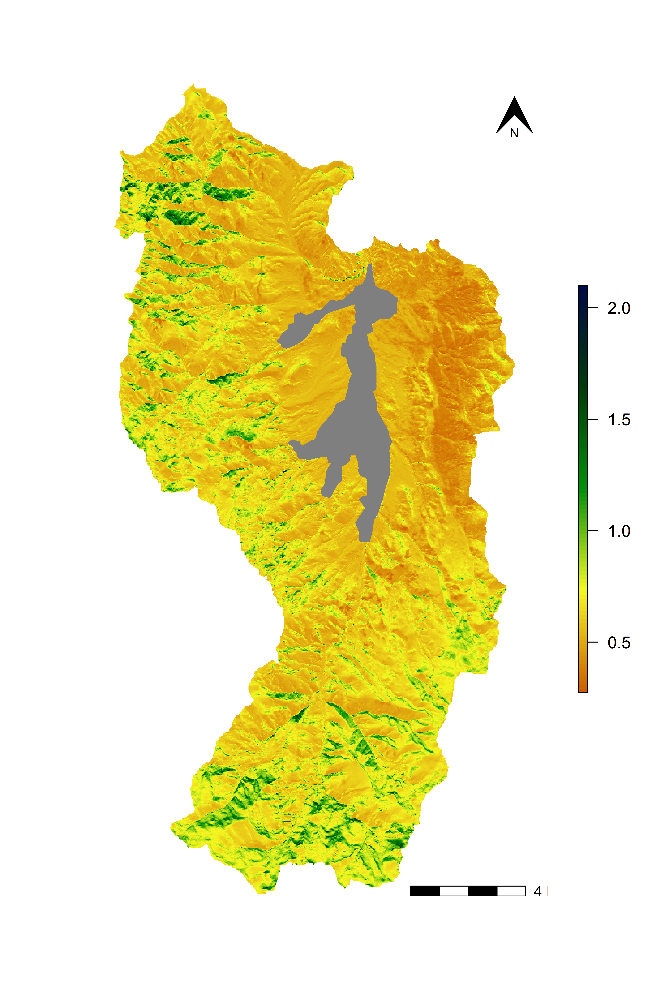
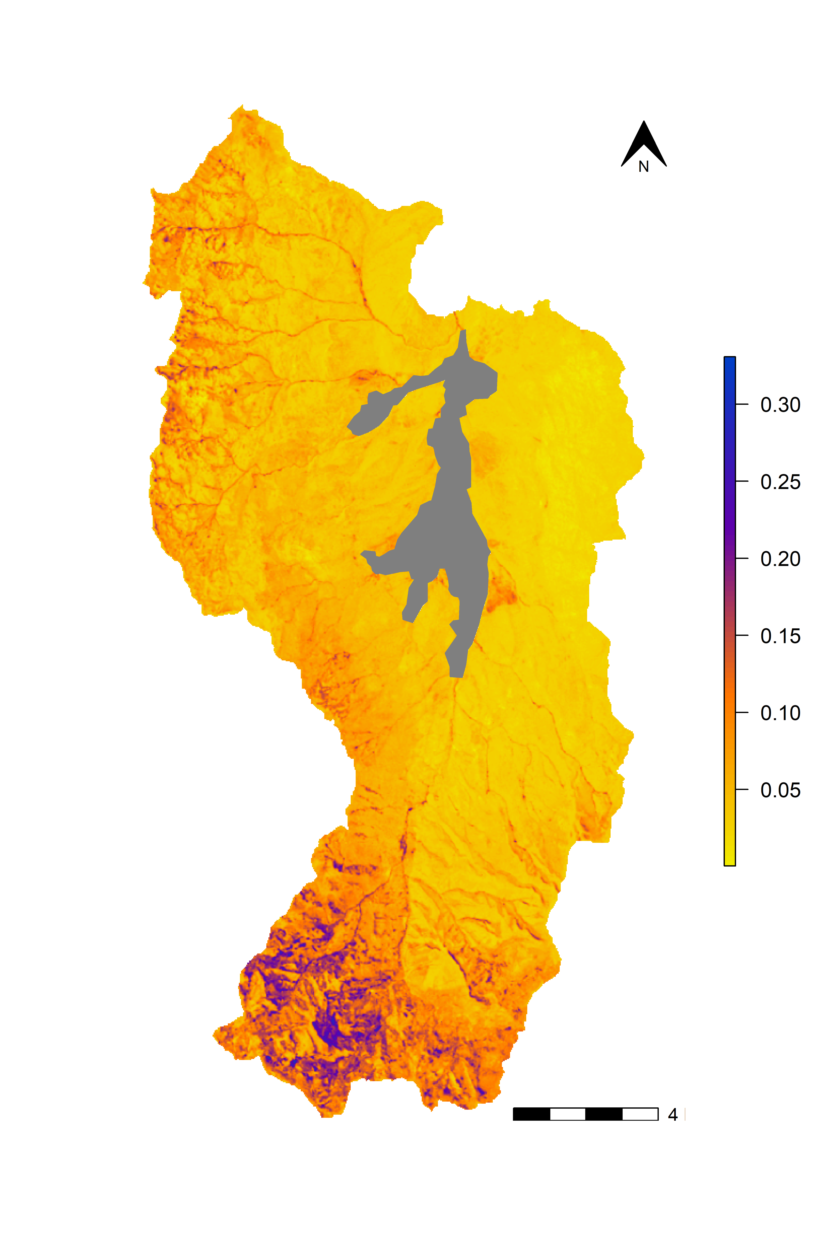
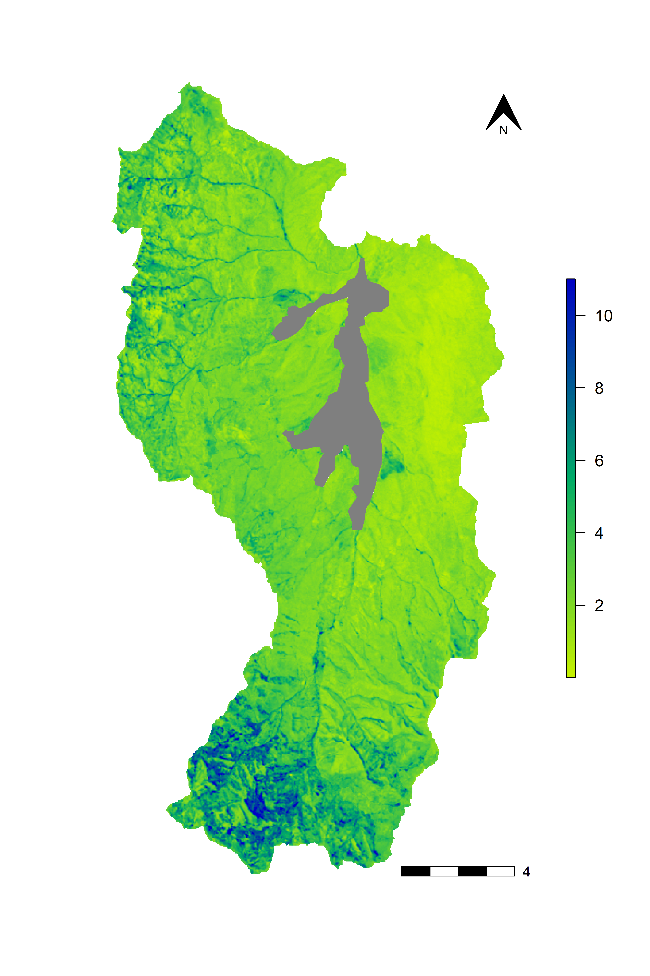
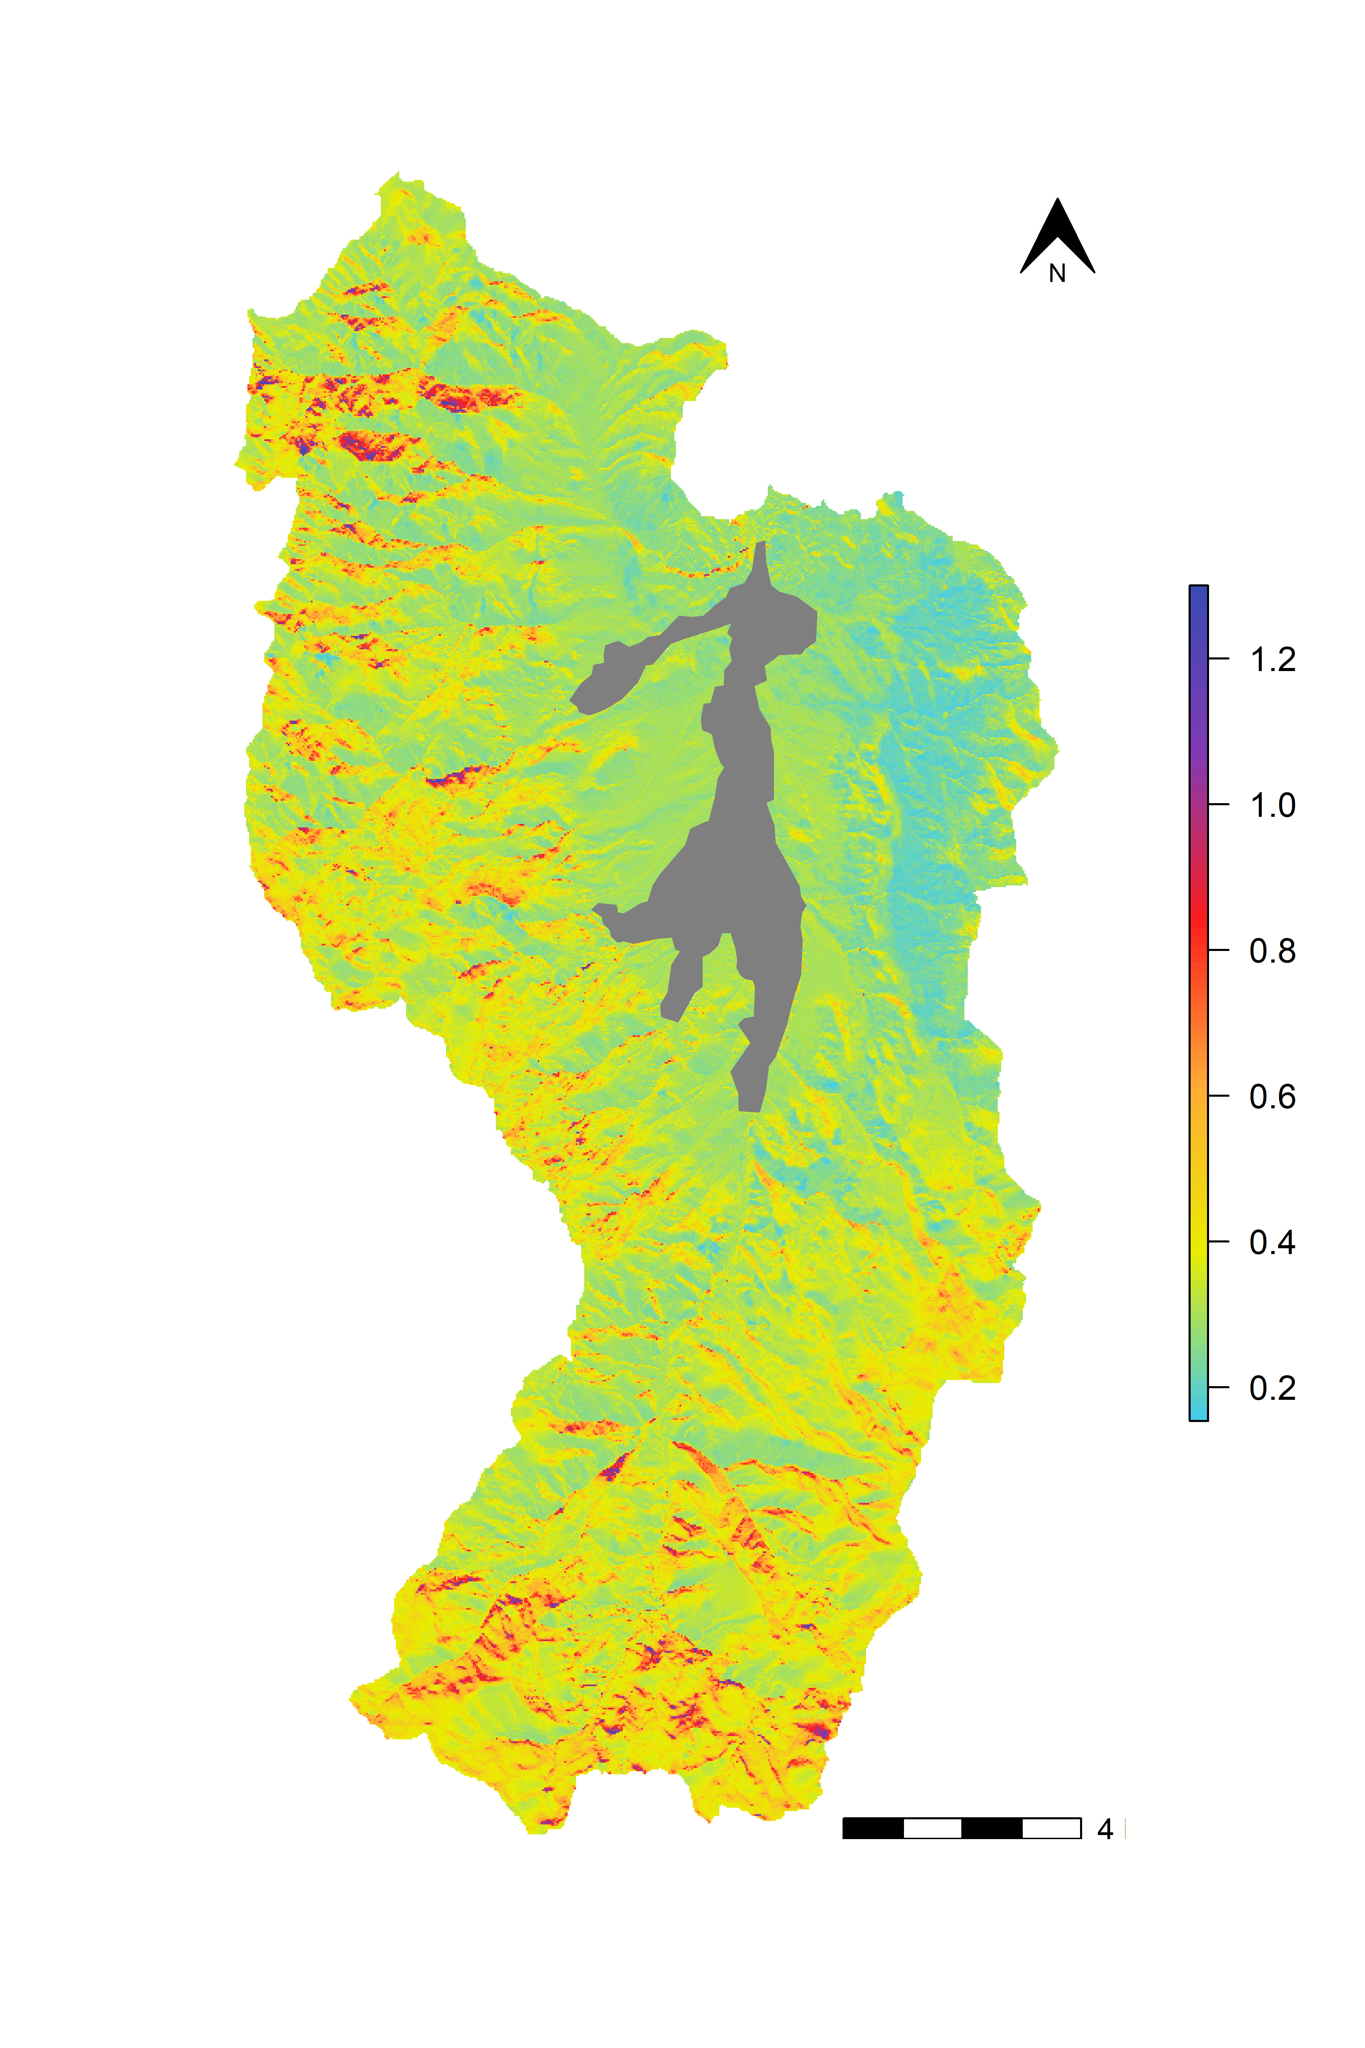
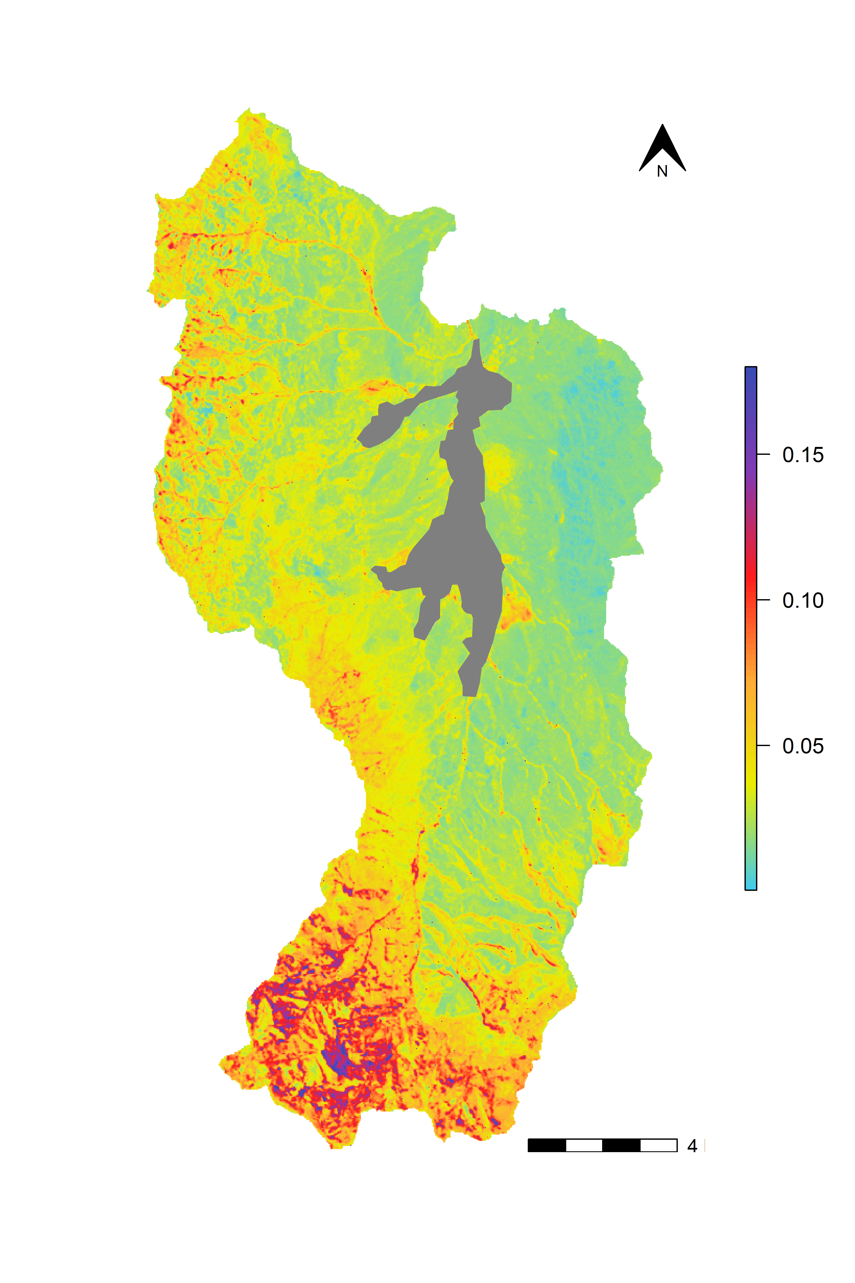
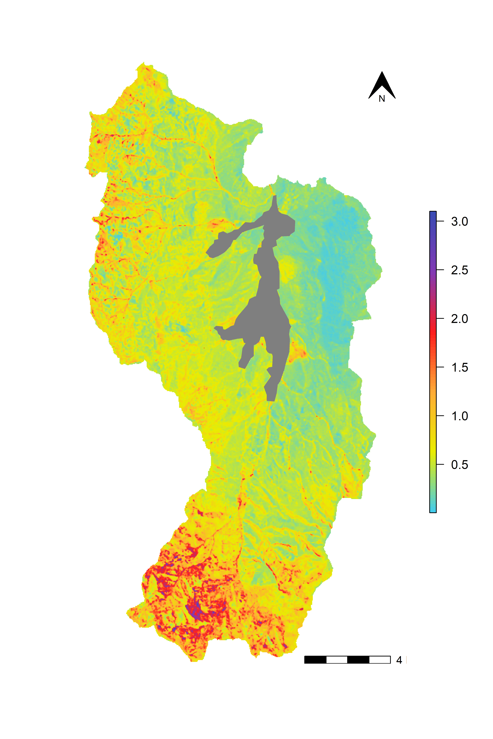
MIMICS Estimate (kg C m⁻²)
Standard Deviation (kg C m⁻²)
Litter C Pool
Microbial C Pool
Protected SOC Pool

